Slide 1
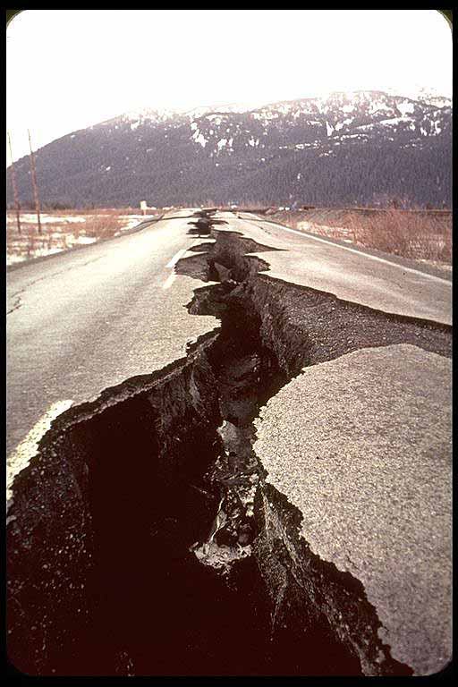
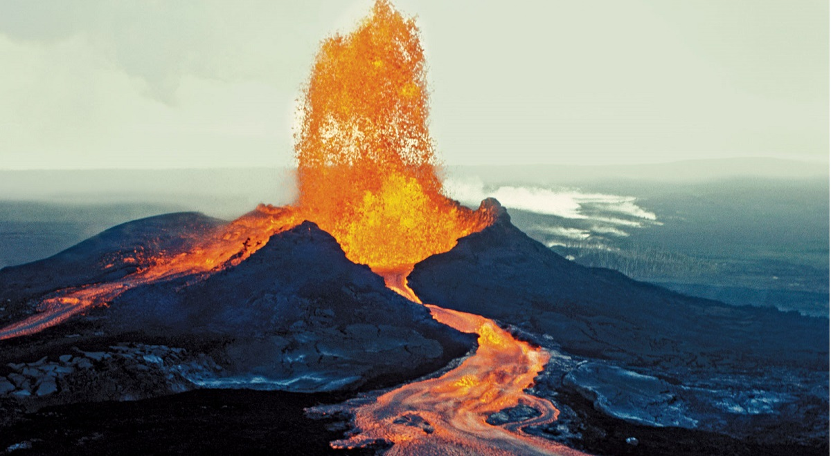
Volcanoes and Earthquakes
This Photo by Unknown Author is licensed under CC BY-SA-NC
Vocabulary
This Photo by Unknown Author is licensed under CC BY-SA-NC

Slide 2
Vocabulary Words
Core
Crust
Earthquake
Fault
Hot spot
Lava
Magma
Mantle
Plate
Ring of Fire
Volcano

Slide 3
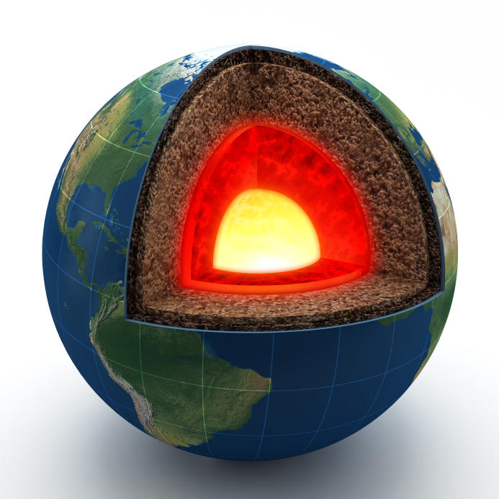
Core
The center part of Earth.
Earth’s core is solid metal surrounded by liquid metal.
This Photo by Unknown Author is licensed under CC BY-SA

Slide 4
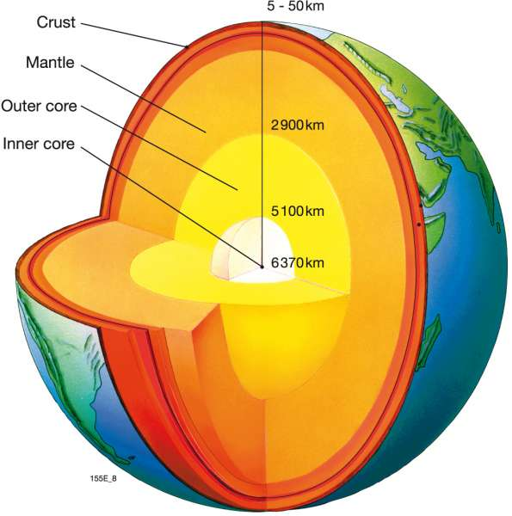
Crust
The top layer of Earth.
Mountains and hills are part of Earth’s crust.
This Photo by Unknown Author is licensed under CC BY-SA

Slide 5
Earthquake
A shaking of the ground caused by the sudden movement of rock.
An earthquake happens when two plates move suddenly.
This Photo by Unknown Author is licensed under CC BY-SA-NC

Slide 6
Fault
A crack in Earth’s crust.
Earthquakes happen along faults.
This Photo by Unknown Author is licensed under CC BY-NC-ND

Slide 7
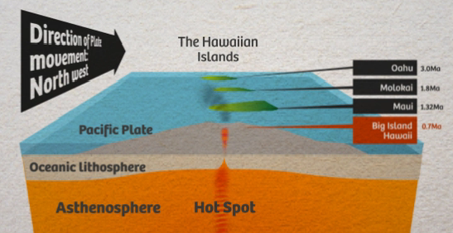
Hot Spot
A place where magma rises from deep within the mantle.
The Hawaiian Islands formed above a hot spot.

Slide 8
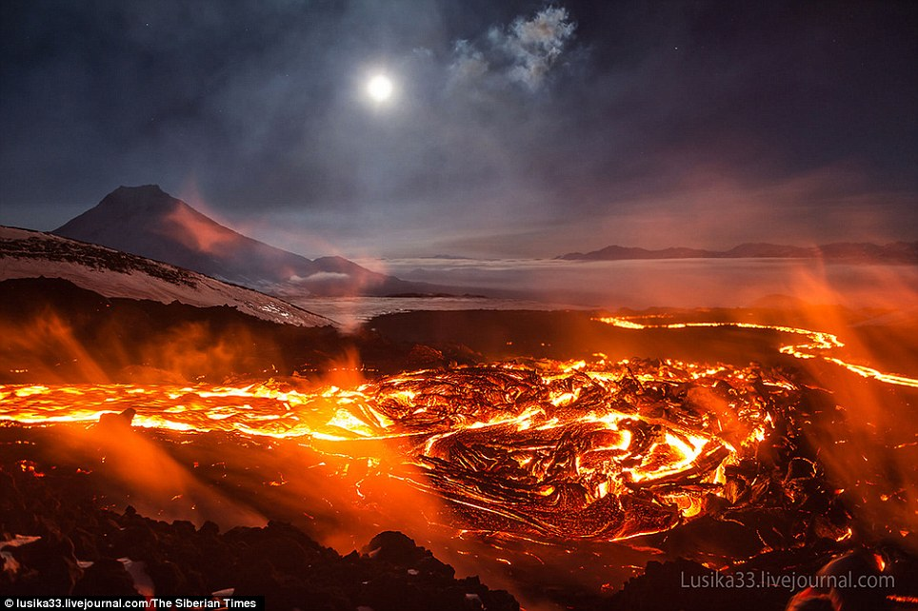
Lava
Melted rock that reaches Earth’s surface.
The volcano erupted lava.
This Photo by Unknown Author is licensed under CC BY-SA-NC

Slide 9
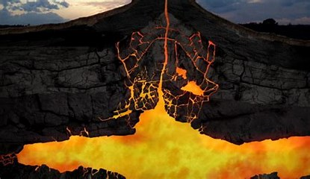
Magma
Melted rock under Earth’s surface.
Magma moves inside a volcano.

Slide 10
Mantle
The middle layer of Earth
Earth’s mantle has a layer of partly melted rock ear the top.
This Photo by Unknown Author is licensed under CC BY-SA

Slide 11
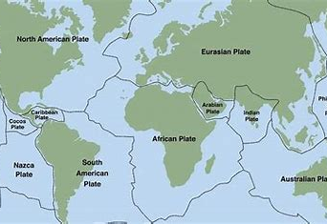
Plate
A large section of Earth’s crust and solid upper part of the mantle.
The edges of some plates meet on land.

Slide 12
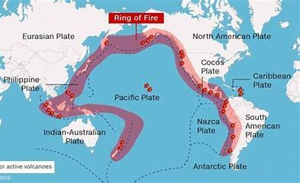
Ring of Fire
An area in the Pacific Ocean where many volcanoes form.
The Ring of Fire includes volcanoes that form along plate boundaries.

Slide 13
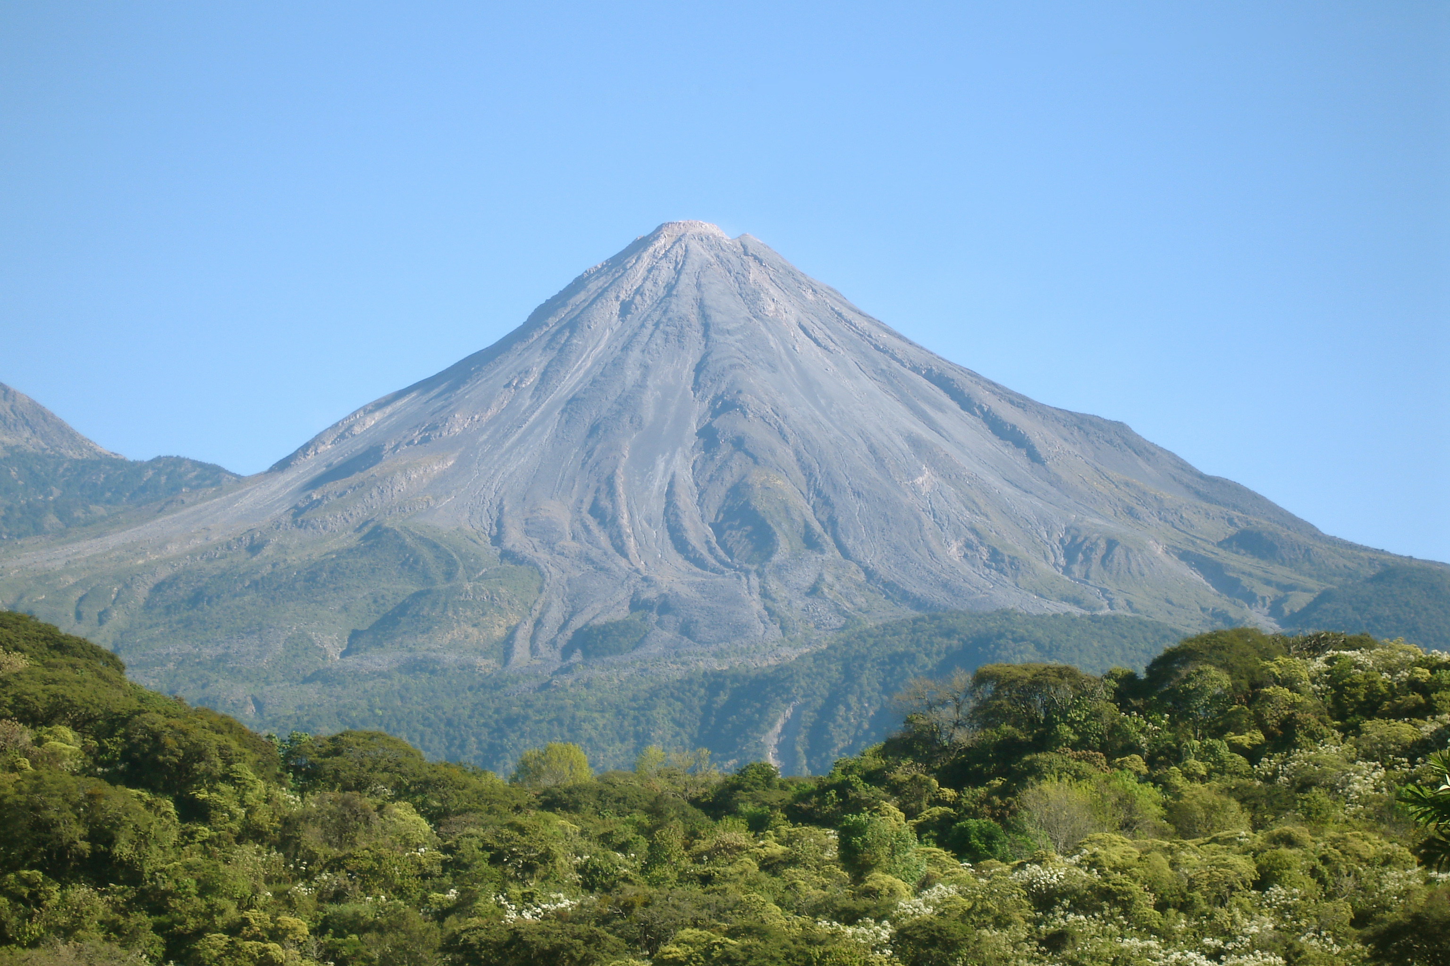
Volcano
This Photo by Unknown Author is licensed under CC BY-SA
This Photo by Unknown Author is licensed under CC BY-SA-NC
A mountain made from melted rock that comes to Earth’s surface and hardens.
Lava erupts from the volcano.

